Slide 1

Team Plowing Panda _
Katia Ossetchkina
Lucas Herzog Bromerchenkel
Thomas de Boer
CIV1498 – Introduction to Data Science for Civil and Mineral Engineers

Slide 2
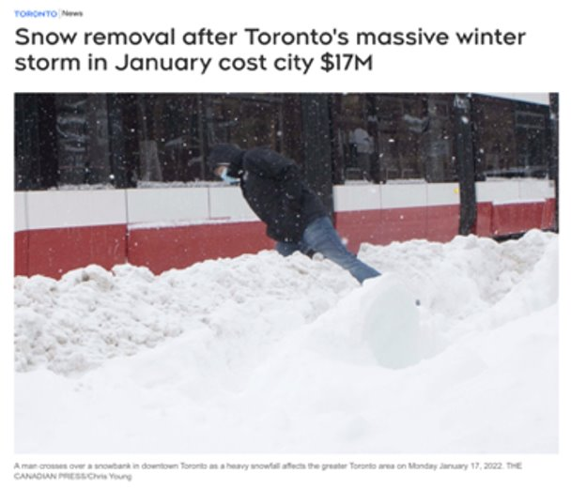

Toronto had one of its most severe snowstorm events on January 16-17th, 2022 (Ranger and Casaletto, 2022):
~45 cm of snow!
In top 10 snow events ever recorded for Toronto (Howes, 2022)
The City was not prepared for this storm (City of Toronto, 2022):
Overspent money – 20% of total annual budget, $17 M
Lack of visibility for Toronto citizens
Low snow-plow deployment rates from facilities
Introduction

Slide 3
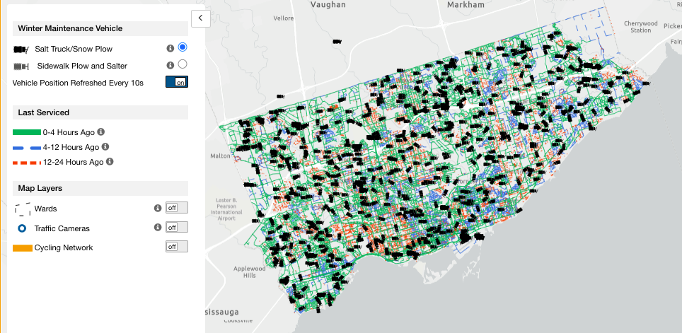
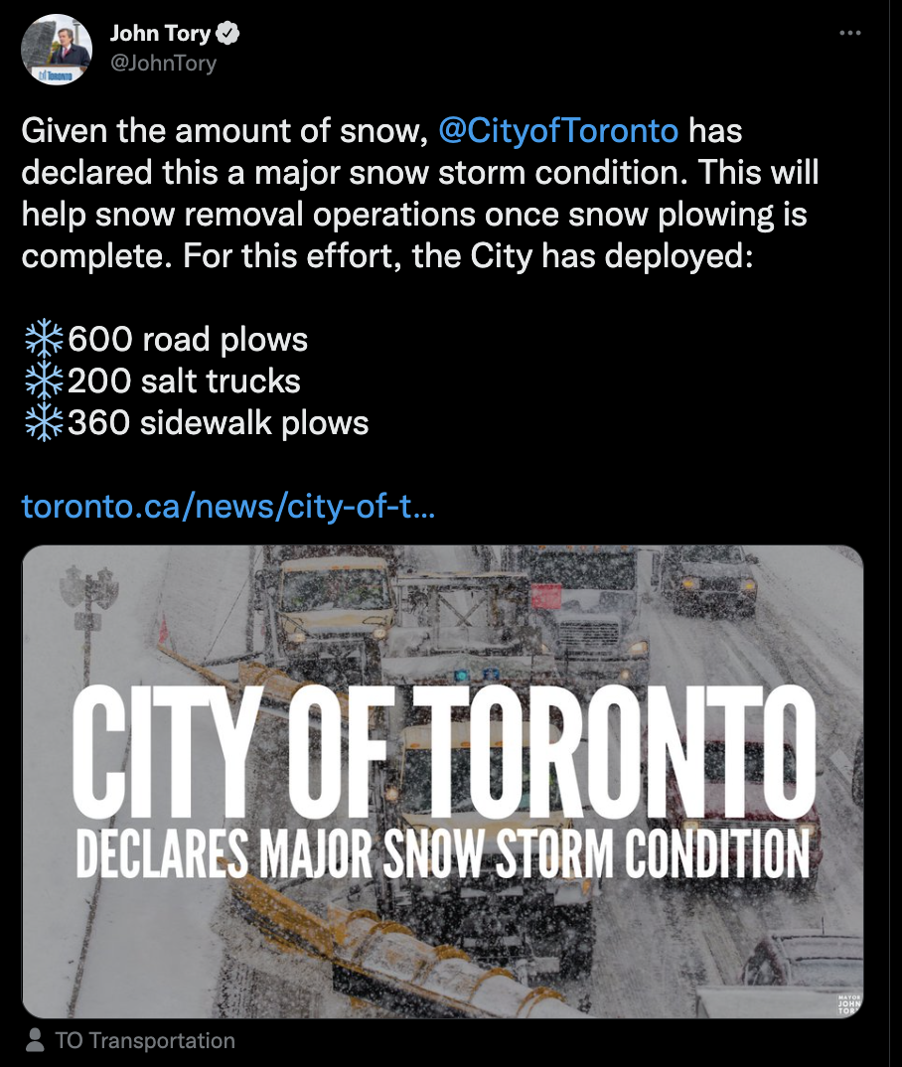
January storm showed the need for a deeper dive into Toronto’s response to severe weather events
PlowTO shows live snowplow locations, but does not provide historic data
In February, the City of Toronto claimed that 600 plows and 200 trucks were deployed for future storm events (Tory, 2022)
Background

Slide 4
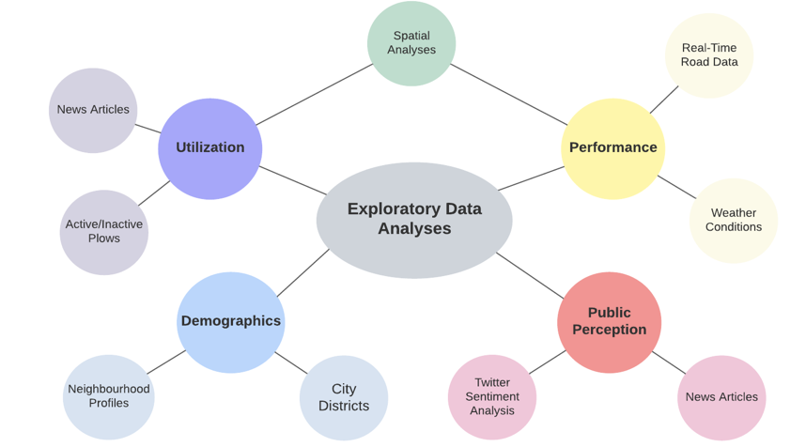
Brainstorming
Notes:
What do we want to know?
Did the city perform better on later storms?
Is the public satisfied with the city’s performance?
How can gauge without historic data?
What kind of metrics would be useful?
How well are plows utilized?
Are all plows out on the road?
Where are most plows?
How well are roads plowed?
What percentage of roads are plowed?
What kinds of roads get plowed first?
Are there patterns to plow performance?
Do certain city districts have better coverage?
Is plow performance tied to demographics?
How do people feel about it?
How can we track public opinion?
Can we see trends in the twitter data?

Slide 5
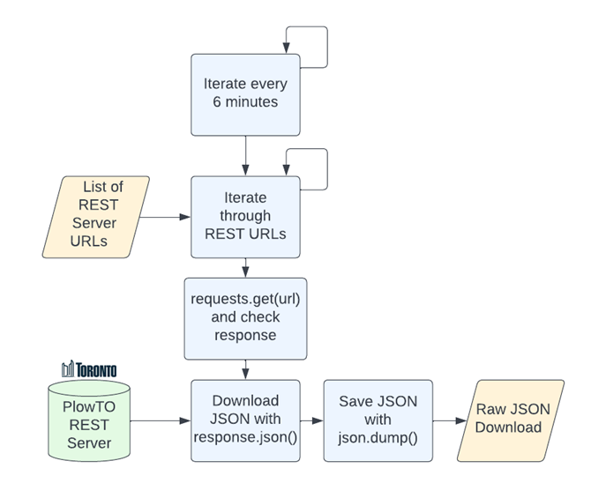
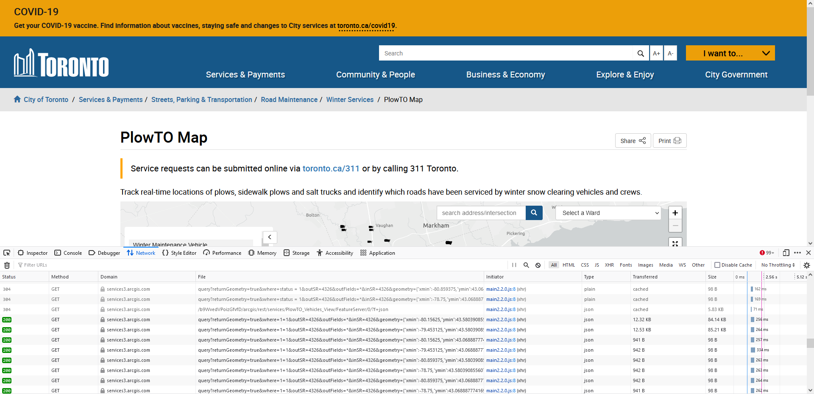
PlowTO Map Data Collection:
PlowTO map data is supplied by the City's ArcGIS REST server
REST server was identified by monitoring network traffic
Python JSON request and response were used to download the live data to a local machine
PlowTO Data Access

Slide 6
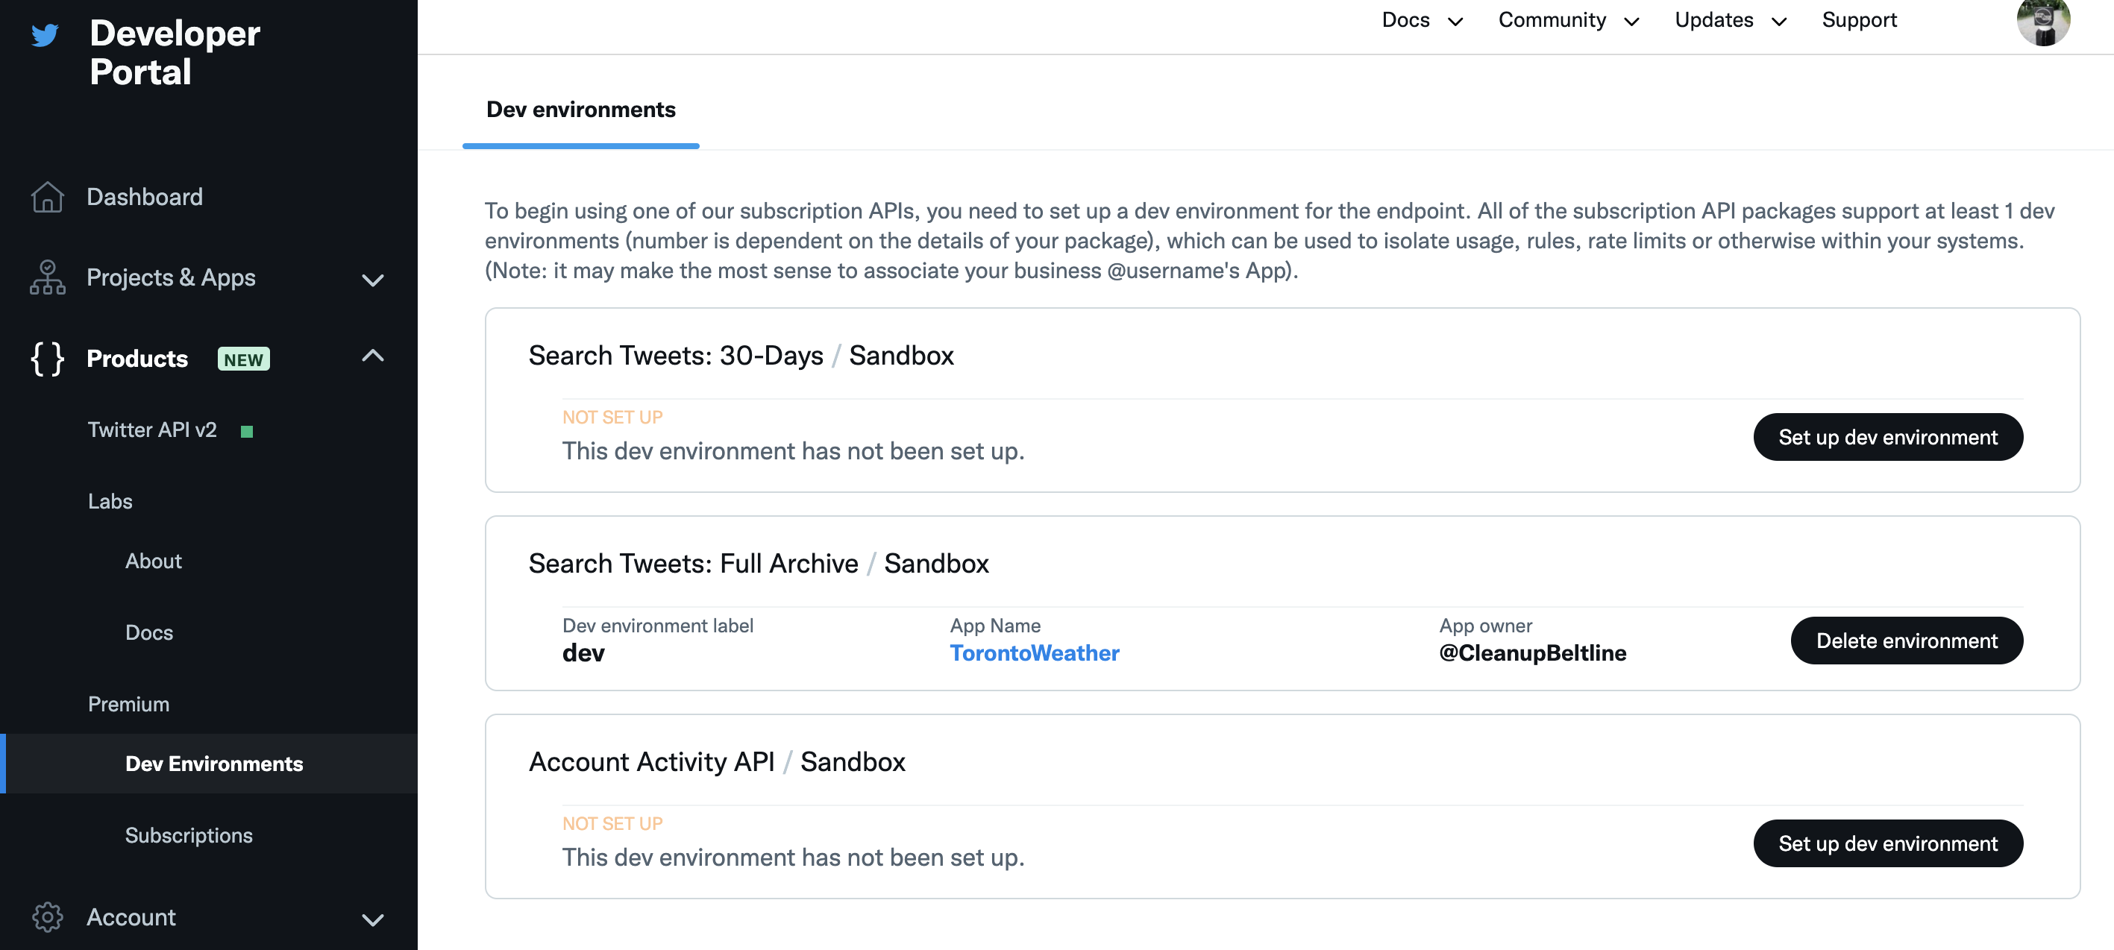
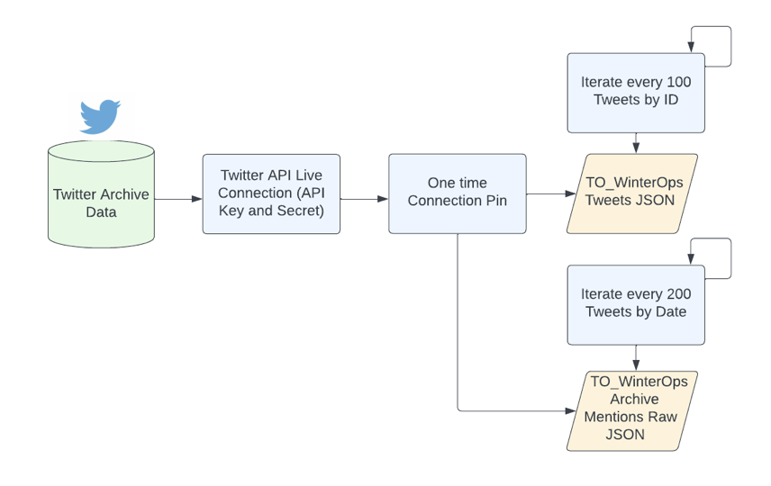
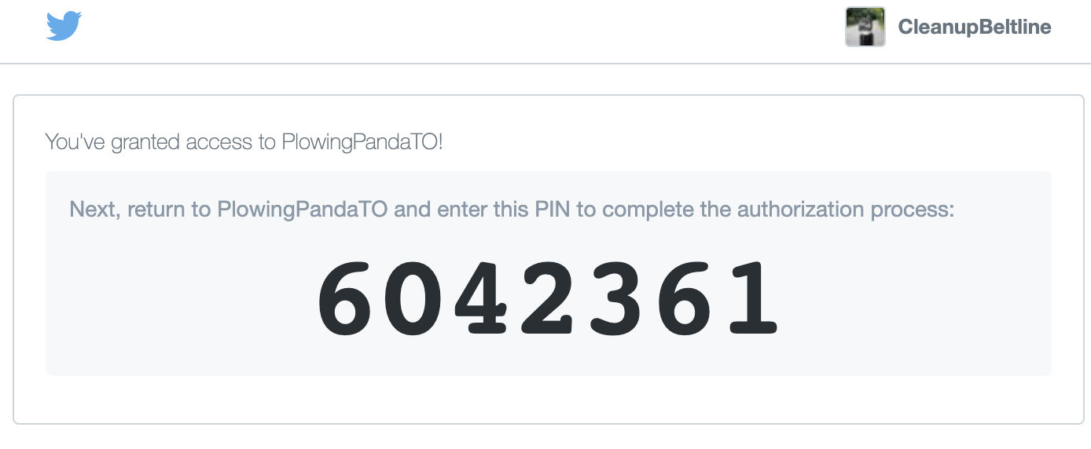
Twitter Data Processing using Twitter API v.2:
Signed up for Elevated Access Twitter Developer account, under academic license
Provided with Key and Secret to setup Twitter API calls
Available to students, with APIs for archive and query capability
Data Extraction: Twitter API

Slide 7
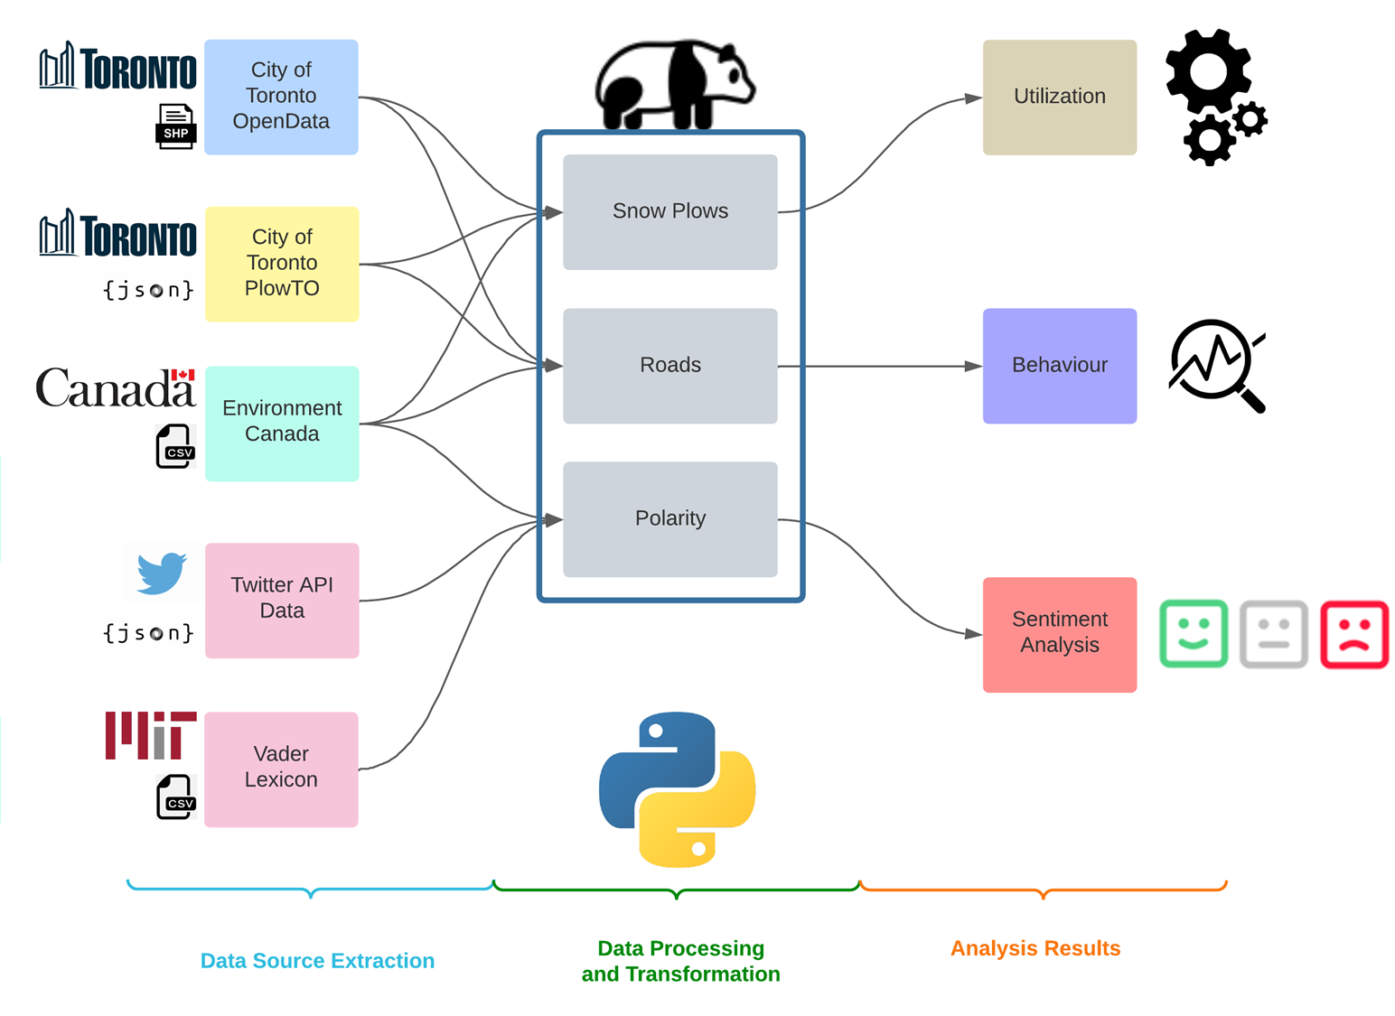
ETL Diagram

Slide 8
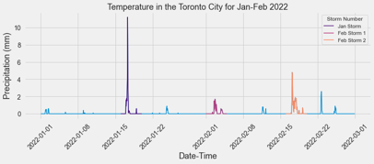
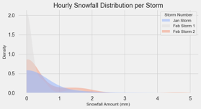
Weather Events and Data Collection:
PlowTO data was collected during two storm events in February
February 2nd to February 4th
February 16th to February 19th
Storm timing was verified using Environment Canada weather data
The Feb. 16th to Feb. 19th storm was selected for further analysis
Winter Storm Events

Slide 9
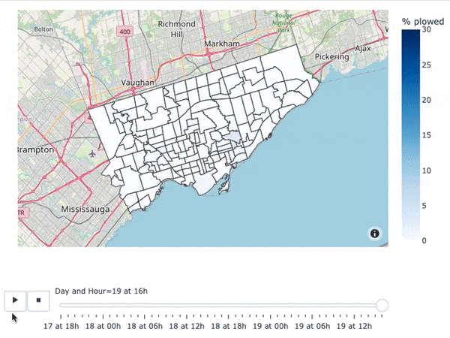
Ratio of Local Roads Plowed per Neighbourhood, per Hour.
Local roads are representative of residential areas
Heavy plowing during early hours, i.e. 2AM to 5AM.
Continuous plowing after storm has ceased
Spatial Patterns in Plowing Behaviour

Slide 10
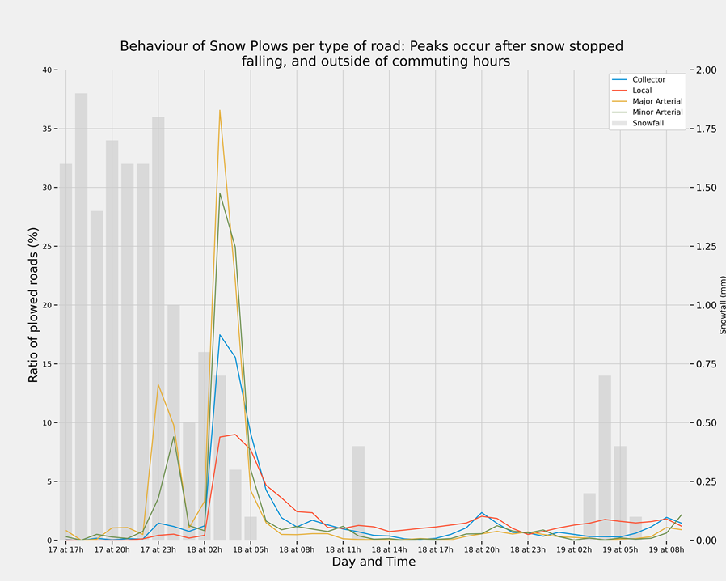
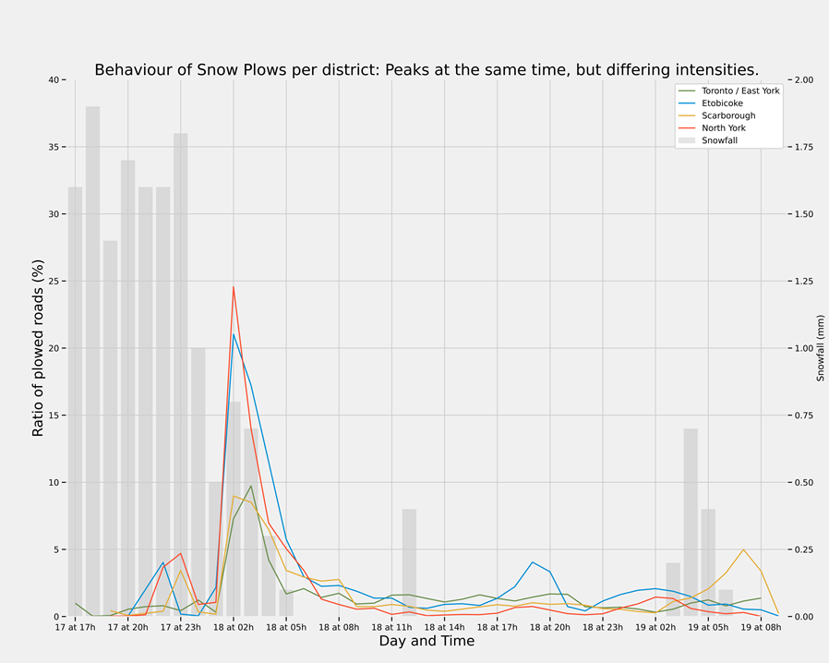
Arterial roads are prioritized;
Local roads are consistently plowed throughout the day;
Plowing Behaviour by District and Road Type

Slide 11
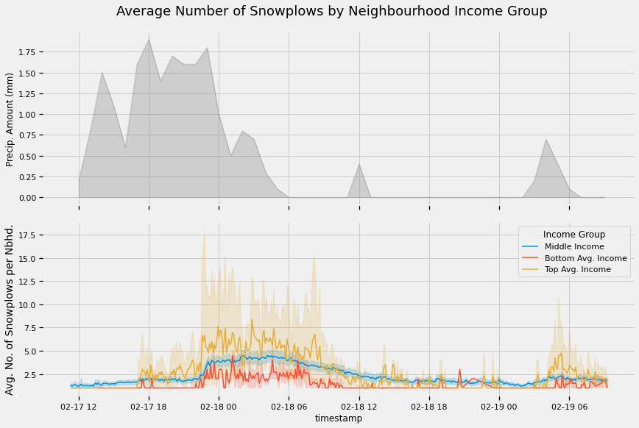
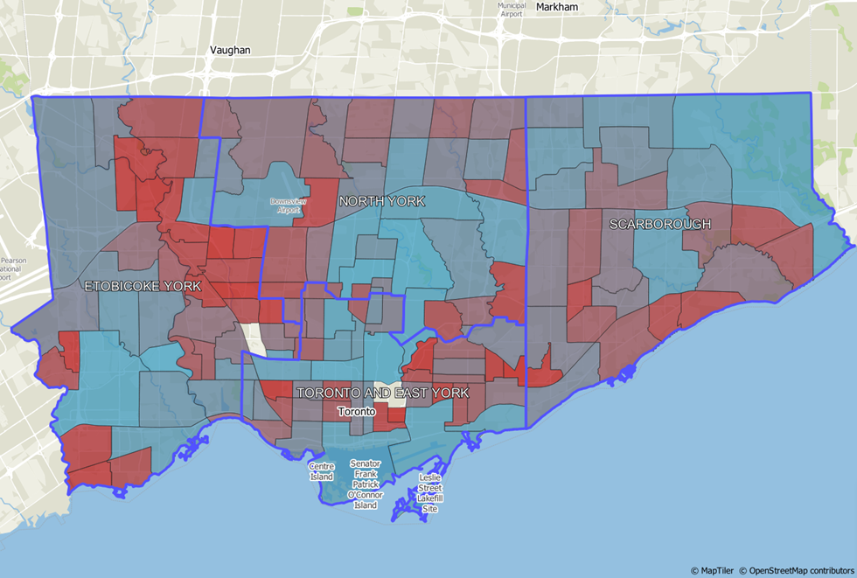
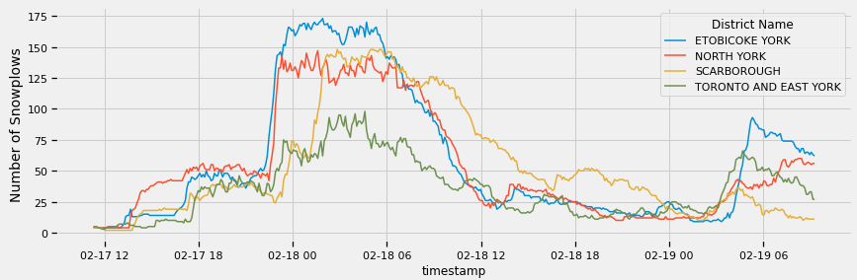
Weather, Average No. of Plows by Nbhd., and Total Number of Plows by District
Neighbourhoods by Average After-Tax Household Income
<100k
>800k
Patterns exist but there are many factors present
Ex: Low and high income neighbourhoods are not all the same size, density, age, infrastructure
Demographics and Behaviour

Slide 12
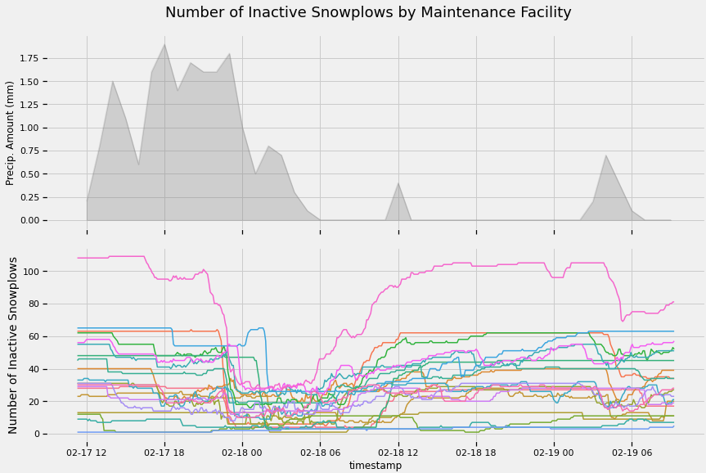
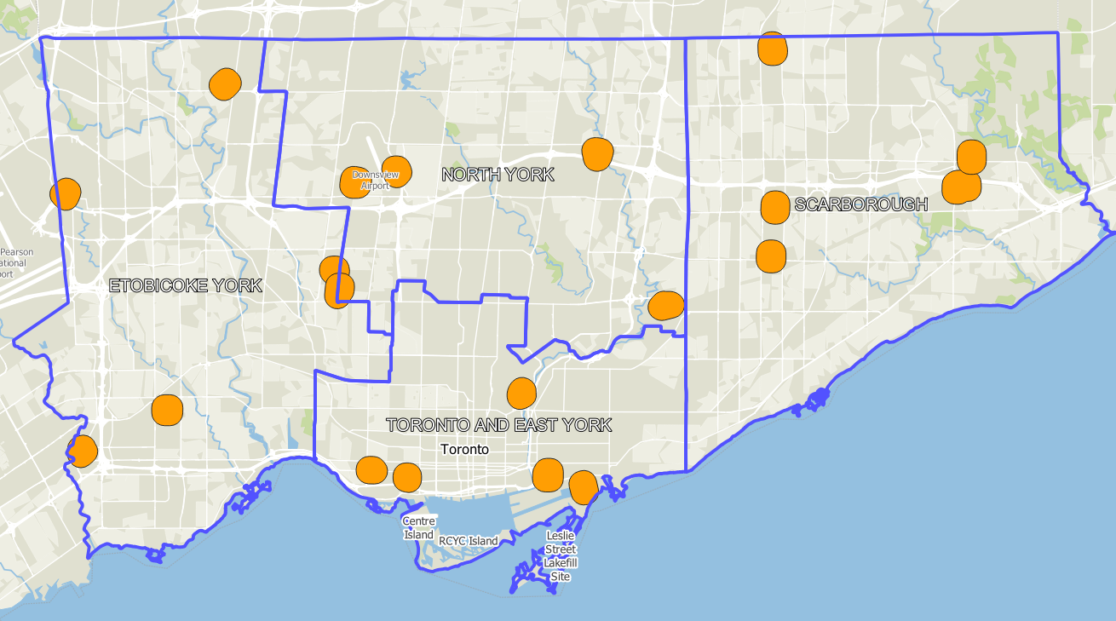
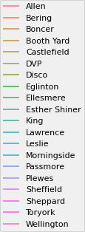
A minimum of 13 and a maximum of 533 of the 800 plows and salt trucks were active at any single time during the Feb 17th – Feb 19th storm
Plows generally operate after the majority of snowfall
Maintenance Facility Locations
Maintenance Facilities and Plow Utilization

Slide 13
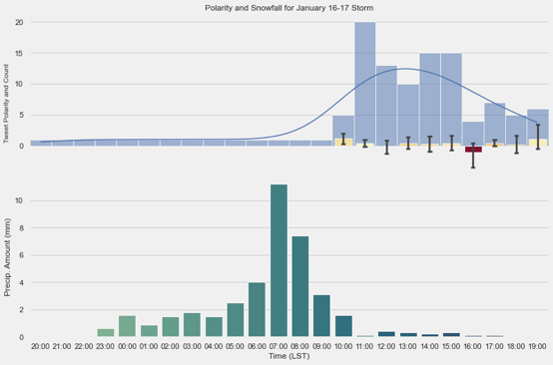
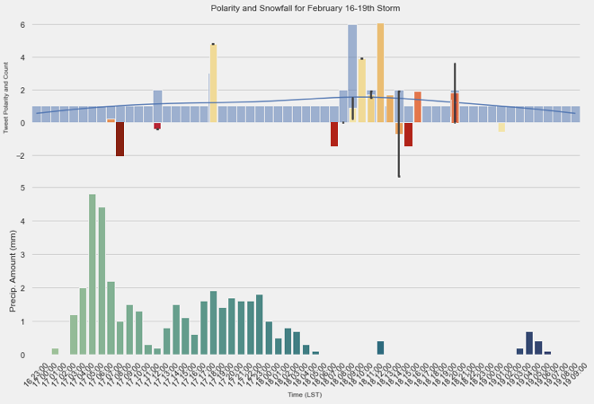
January Storm:
100 Mentions in Tweets
63% negative, 37% positive
2nd February Storm:
31 Mentions in Tweets
48% negative, 52% positive
@to_winterops @311toronto these guys are such liars and have terrible workers i have lived at my address 12 years I haven't seen anything like this
@to_winterops @311toronto where can i complain about your asshat plow driver on front st and john clogging the corner
Sentiment Analysis of TO_WinterOps

Slide 14
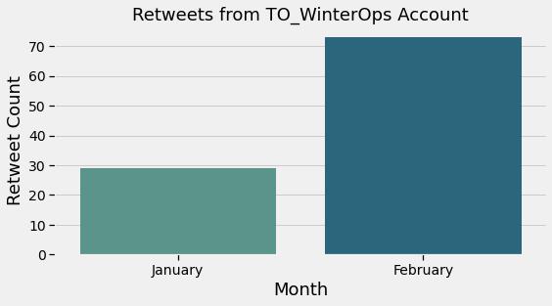
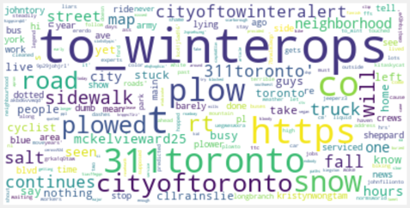
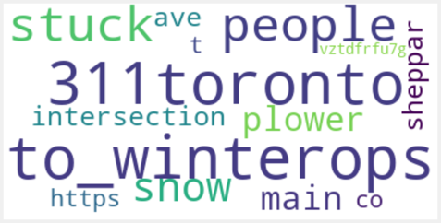
There was improvement of perception in February:
More engagement by resharing City tweets
In January storm, a lot of complaints about a road not being plowed
In February storm, a lot of positive tweets focused on a road being plowed
Sentiment Analysis of TO_WinterOps cont

Slide 15
Conclusion:
The city appears to have performed well in the February storms
There seems to be a relationship between demographics and plowing behaviour
Public perception of City generally improved since January storm
Future Work:
Medium articles to cover Twitter, REST server access, and map creation
Set up data server to collect and store data automatically
Use dictionaries to extract locations from tweets, to add spatial element
Assess the impact of other demographic information on plow performance
Conclusion and Future Work

Slide 17
References
City of Toronto. (2022). January 16-17, 2022 Major Snow Event Post-Operational Report. 32.
Howes, N. (n.d.). Epic January winter storm cost Toronto $17+ million for snow removal. Retrieved April 13, 2022, from https://ca.news.yahoo.com/epic-january-winter-storm-cost-233439041.html
Ranger, M., & Casaletto, L. (n.d.). “Work is ongoing 24 hours a day,” Toronto snow removal continues after epic storm | CityNews Toronto. Retrieved April 13, 2022, from https://toronto.citynews.ca/2022/01/18/toronto-snow-removal-cleanup/
Tory, J. (2022, January 17). https://toronto.ca/news/city-of-toronto-declares-major-snow-storm-condition-ahead-of-snow-removal-operations/ https://t.co/6tHqyX7jNx [Tweet]. Twitter. https://twitter.com/JohnTory/status/1483224963553406980
References

Slide 18
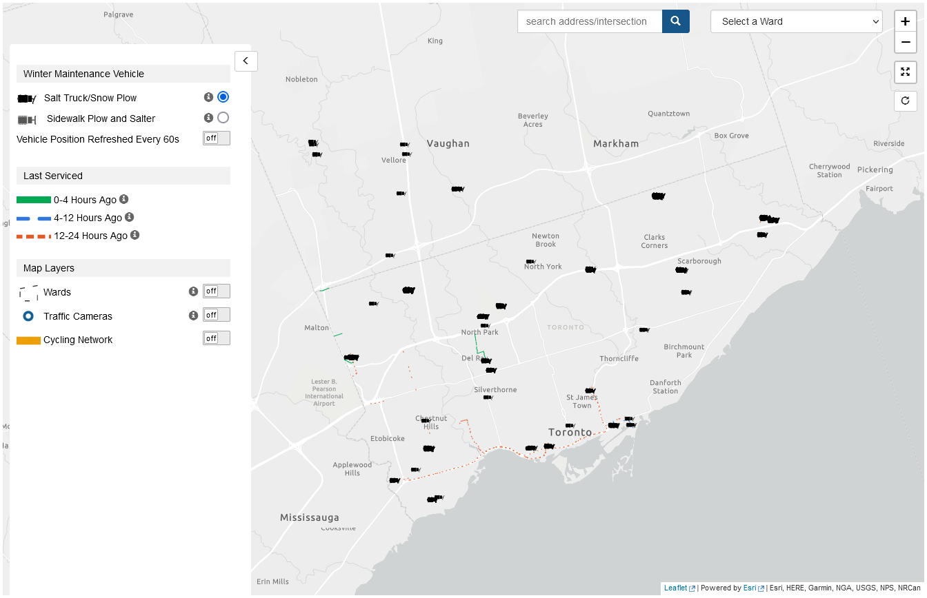

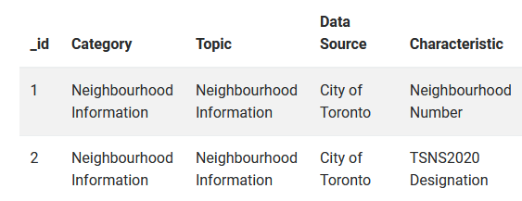
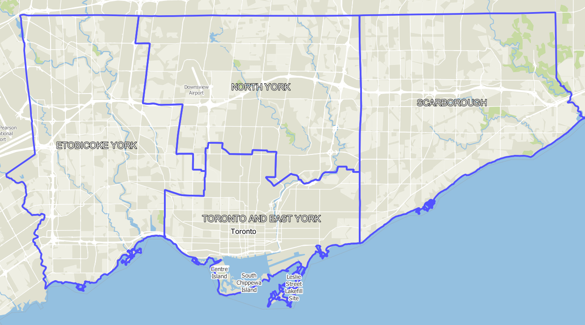
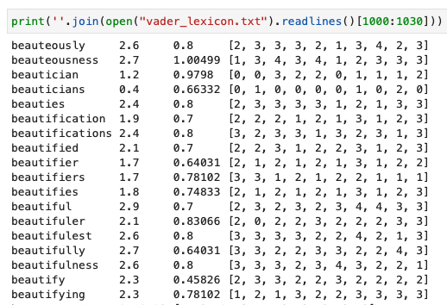
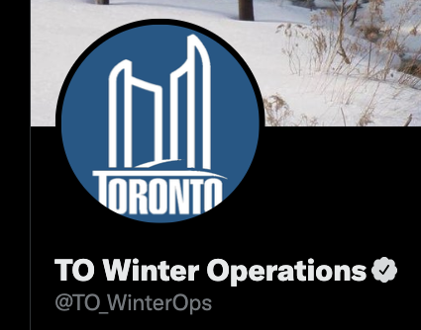
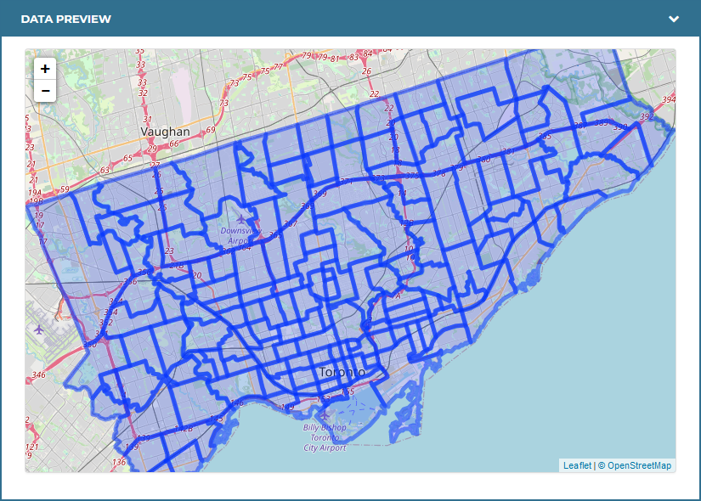
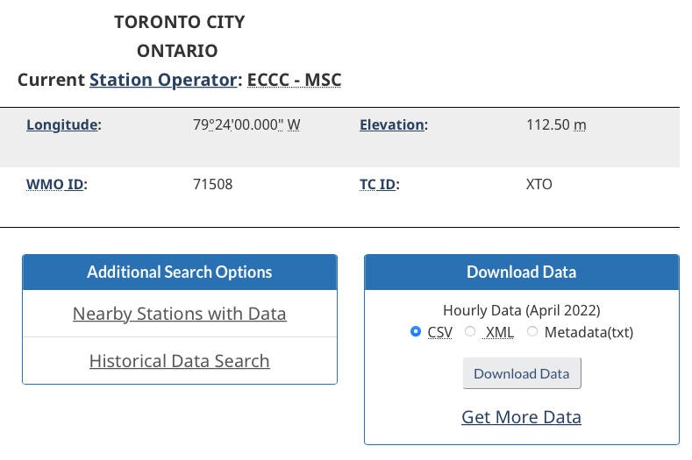
CSVs
JSONs
Shapefiles
Data Sources

